Slide 1


Microsoft Defender for Endpoint and IoT Based on the Aliquippa Cyberattack
Soyeong Cha (Selena)
ISM 6331
Information Systems Security

Slide 2

Notes:
Hearest Television – news source (Washington, D.C. news bureau)

Slide 3
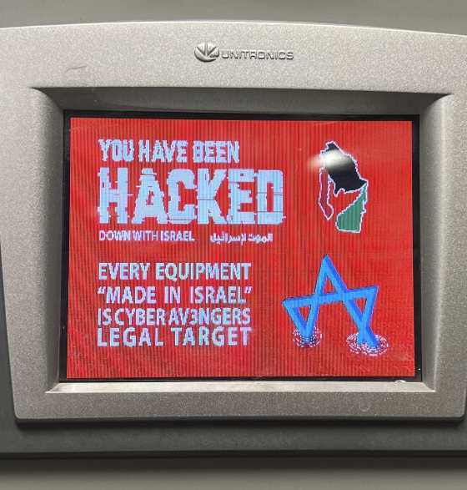
The Case: What Happened in Aliquippa
“CyberAv3ngers” exploited a public-facing PLC at MWAA's booster station
PLC had default credentials and no segmentation or firewall
The display was defaced with political messaging
The attack was detected only after the damage was done
Source: 90.5 WESA

Slide 4
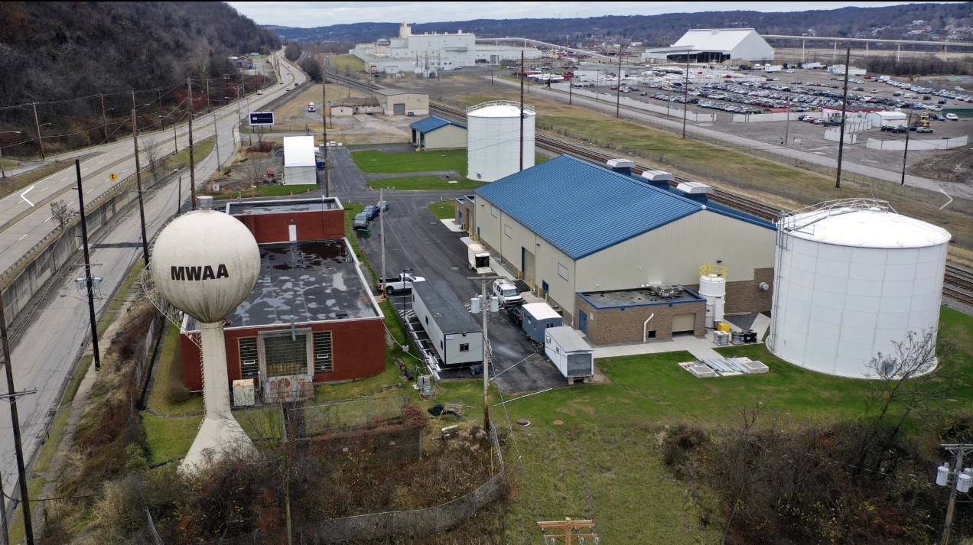
Infrastructure Weaknesses
Unitronics Vision Series PLC:
No encryption
No access controls
No logging
No segmentation
CISSP Chapter 3 & Zero Trust principles violated
Source: AP US News

Slide 5
CISSP Framework Breakdown
Ch. 1: No policy/governance → Defender provides risk scoring
Ch. 2: Unmanaged PLC → Defender for IoT discovers assets
Ch. 3: No zoning or telemetry → Defender enforces architecture
Ch. 4: No response workflow → Defender enables automated response
Ch. 5: Default credentials → Defender supports MFA/RBAC
Ch. 8: No testing → Defender flags misconfigurations and CVEs
Ch. 9: No monitoring → Defender connects to Sentinel
Ch. 15: No fallback → Defender isolates without service loss
Ch. 17: Flat network → Defender enforces boundaries
Ch. 18: Unpatched firmware → Defender detects and compensates

Slide 6
Articles Support
Khan et al. (2022): SCADA risk, need for protocol-aware IDS
Alcaraz & Zeadally (2023): Zero Trust, passive OT monitoring
Defender aligns with both recommendations

Slide 7
Defender Capabilities
Defender for Endpoint:
Behavioral analytics
Block & isolate
CVE-based remediation
Defender for IoT:
Passive monitoring
Protocol inspection (e.g., Modbus)
Asset classification
Integrated response
& SIEM support

Slide 8
Why You Need Both Defender for Endpoint and Defender for IoT Script?
Tool | Protects IT (Laptops/Servers) | Protects OT (PLCs/SCADA) | Active Protection | Passive Monitoring
Defender for Endpoint | Yes | No | Yes | No
Defender for IoT | No | Yes | No | Yes

Slide 9
Cost & Tool Comparison
Product | Strengths | Weaknesses | Cost
Defender | Unified IT/OT, Microsoft stack | Best for Microsoft environments | Included in Microsoft 365 E5 ($57/user/month) or licensed per OT traffic volume
CrowdStrike | Fast EDR, good intel | Limited OT, expensive | $60–$100+/endpoint
SentinelOne | Easy deployment | Not OT-specific | $70–$120+/endpoint
Claroty/Nozomi | OT native, deep protocol | High cost | $100K+ per year

Slide 10
Implementation Plan
IT: Deploy Defender via Intune
OT: Follow Defender for IoT Deployment Guide:
Install management console
Connect SPAN/TAP
Baseline and discover
Tune alerts
Aligns with CISSP Chapter 8 testing & validation

Slide 11
Installation Phase for Defender Deployment
Phase | Description
Phase 1 | Review network setup and identify vulnerable computers and PLCs
Phase 2 | Install Defender for Endpoint on pilot workstations via Microsoft Intune
Phase 3 | Set up Defender for IoT, mirror traffic with SPAN/TAP, and discover devices
Phase 4 | Tune alert rules and monitor results for false positives
Risk Evaluation and Mitigation Strategies
Feature | Mitigation Strategy
Staff unfamiliarity | Provide training on using Defender dashboards and interpreting alerts
False positives | Start with limited alert scope and fine-tune rules
Legacy system compatibility | Use passive monitoring instead of agent-based tools
Operational disruption | Roll out in phases to avoid interrupting live systems

Slide 12

Summary of Benefits
End-to-end threat detection
Passive OT visibility
Identity-based control
Supports Zero Trust & CISSP
Affordable and scalable

Slide 13
Demo Preview
Simulate exposed PLC (Unitronics)
Defender detects and flags default login attempt
Engineering laptop involved
Device isolated, lateral threat stopped

Slide 14
Conclusion & Q&A
Defender addresses every CISSP failure at MWAA
Converts reactive response into proactive protection

